Slide 1

eRideSafe
A simpler way for Sammamish riders to learn the rules and ride safely.
Annirudh Raman
Eastlake High School • 9th Grade
Notes:
Open with the app name, one-sentence promise, and participant name.
[Sources]
- /Users/annirudhraman/Desktop/Coding Projects/eRideSafe Project /eRideSafe/Views/Components/DesignSystem.swift
- /Users/annirudhraman/Desktop/Coding Projects/eRideSafe Project /eRideSafe/Resources/Assets.xcassets/AppIcon.appiconset/AppIcon1024x1024.png

Slide 2
THE PROBLEM
02
Reckless E-bike Riding
Notes:
Explain why a single safety journey matters. Avoid unsupported statistics.
[Sources]
- /Users/annirudhraman/Desktop/Coding Projects/eRideSafe Project /eRideSafe/App/RootTabView.swift
- /Users/annirudhraman/Desktop/Coding Projects/eRideSafe Project /eRideSafe/Views/Home/HomeView.swift

Slide 3




MY SOLUTION
02
Spreading Awareness
Many young riders and families do not have one clear, easy place to understand their vehicle, learn where they may legally ride, and develop safe habits before going out on the road or trail.
Bike class
Class 1, 2, 3, and e-motorcycles all follow different rules and must abide by different laws.
Legal routes
Roads and trails have different access rules.
Without clear guidance, riders may miss hazards or make unsafe choices that can lead to accidents.
Safe habits
Riders need training before they start.
Notes:
Explain why a single safety journey matters. Avoid unsupported statistics.
[Sources]
- /Users/annirudhraman/Desktop/Coding Projects/eRideSafe Project /eRideSafe/App/RootTabView.swift
- /Users/annirudhraman/Desktop/Coding Projects/eRideSafe Project /eRideSafe/Views/Home/HomeView.swift

Slide 4


SOLUTION
03
One app for the whole safety journey
eRideSafe helps riders find their bike class, learn local rules, check where they can ride, report hazards, and get clear alerts during a ride.
WHY I BUILT IT
WHO IT HELPS
Because of accidents due to misinformation, reckless driving, and increasing unsafe e-Bike usage.
Students, new riders, and families in Sammamish
Notes:
Deliver the purpose in one clear sentence, then name the audience.
[Sources]
- https://www.congressionalappchallenge.us/wp-content/uploads/2026/05/2026-CAC-Rules.pdf
- /Users/annirudhraman/Desktop/Coding Projects/eRideSafe Project /eRideSafe/App/RootTabView.swift

Slide 5



HOW IT WORKS
03
The app works using five simple features
01
02
03
04
05
CLASSIFY
LEARN
MAP
REPORT
RIDE
Find your bike class
Learn the safety basics
See where you can ride
Warn others about hazards
Get live safety alerts
Notes:
[Sources]
- /Users/annirudhraman/Desktop/Coding Projects/eRideSafe Project /eRideSafe/App/RootTabView.swift

Slide 6


CORE FUNCTIONALITY
05
Three features make understanding the rules easier
01
02
03
Safety Map
eRide School
Community Reports
Shows where each e-bike class is allowed, plus restricted trails, caution roads, schools, and local speed guidance.
Five short lessons and a quiz teach the rules. Riders can track progress and earn a certificate.
Riders can report hazards. The backend syncs the reports so everyone sees the latest information.
Notes:
Show how the map, course, and reports combine prevention with community knowledge.
[Sources]
- /Users/annirudhraman/Desktop/Coding Projects/eRideSafe Project /eRideSafe/Views/Home/HomeView.swift
- /Users/annirudhraman/Desktop/Coding Projects/eRideSafe Project /eRideSafe/Services/FirebaseBackend.swift

Slide 7




LIVE RIDE MODE
06
Ride Mode keeps alerts simple
PRE-RIDE
17
Finish a quick safety checklist
LIVE SPEED
Compare GPS speed with the zone limit
MPH
MOTION
UNDER LIMIT
Detect rough or sudden phone movement
SHARE
Example: Sammamish River Trail • 20 mph
Share the current location with one tap
Notes:
Demonstrate the pre-ride checklist, live GPS speed, zone limit, motion sensor, audio/haptic alerts, and location sharing.
[Sources]
- /Users/annirudhraman/Desktop/Coding Projects/eRideSafe Project /eRideSafe/Views/Ride/RideModeView.swift

Slide 8



TOOLS + PROGRAMMING
07
Built using Swift and Firebase
APP
SwiftUI + iOS
Screens, navigation, and saved progress
SENSORS + MAPS
CHALLENGE + LESSON
MapKit • CoreLocation • CoreMotion • AVFoundation
Routes, GPS speed, motion, and spoken alerts
Live sensor data changes fast. I learned to turn it into short, clear alerts that do not distract the rider.
CLOUD
Firebase Authentication + Firestore
User profiles and shared hazard reports
Notes:
Explain the technical stack and the core challenge: turning sensor streams and mapped rules into safe, usable feedback.
[Sources]
- /Users/annirudhraman/Desktop/Coding Projects/eRideSafe Project /eRideSafe/Views/Ride/RideModeView.swift
- /Users/annirudhraman/Desktop/Coding Projects/eRideSafe Project /eRideSafe/Services/FirebaseBackend.swift

Slide 9
App Demonstration

Slide 10
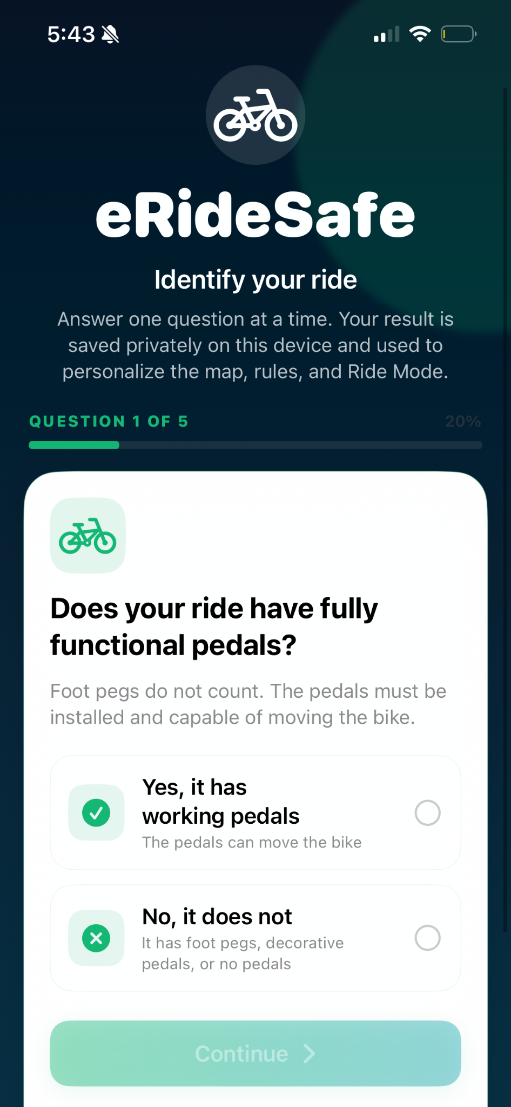
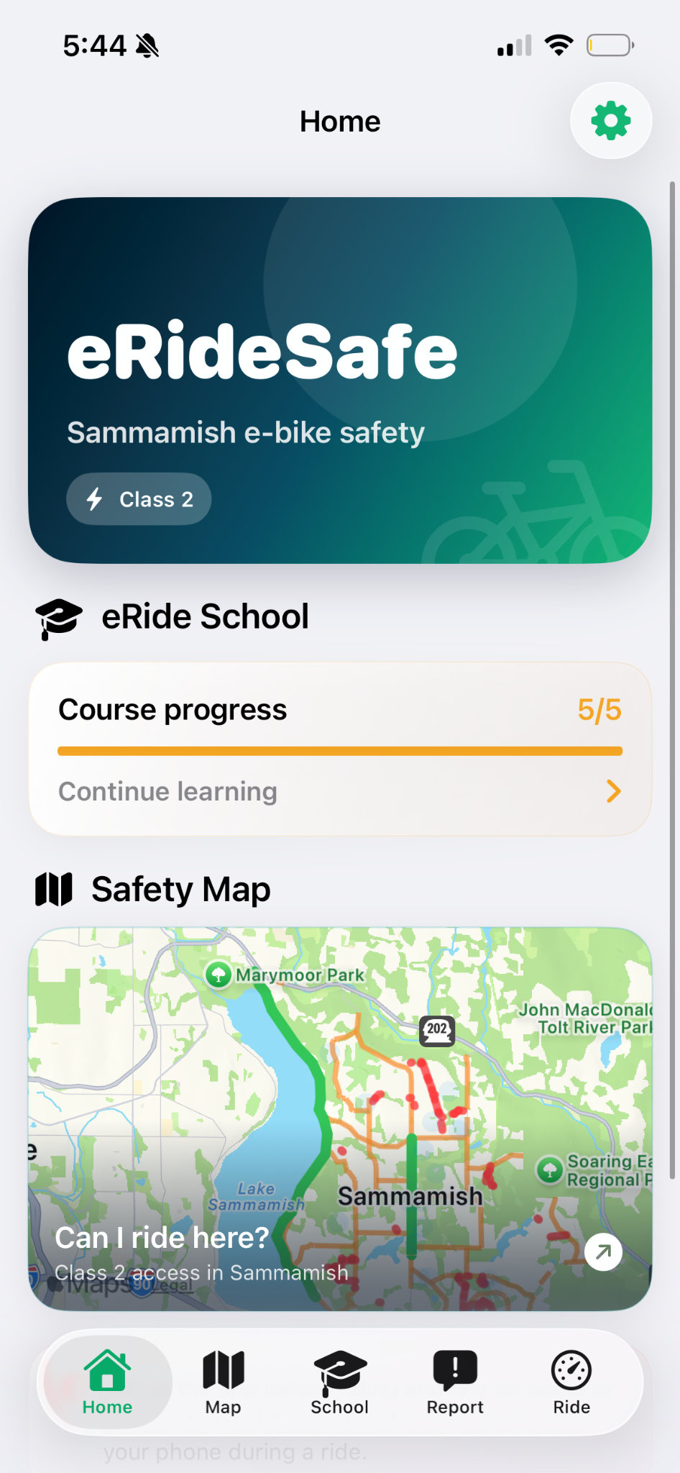
Starting screen
Home Page

Slide 11
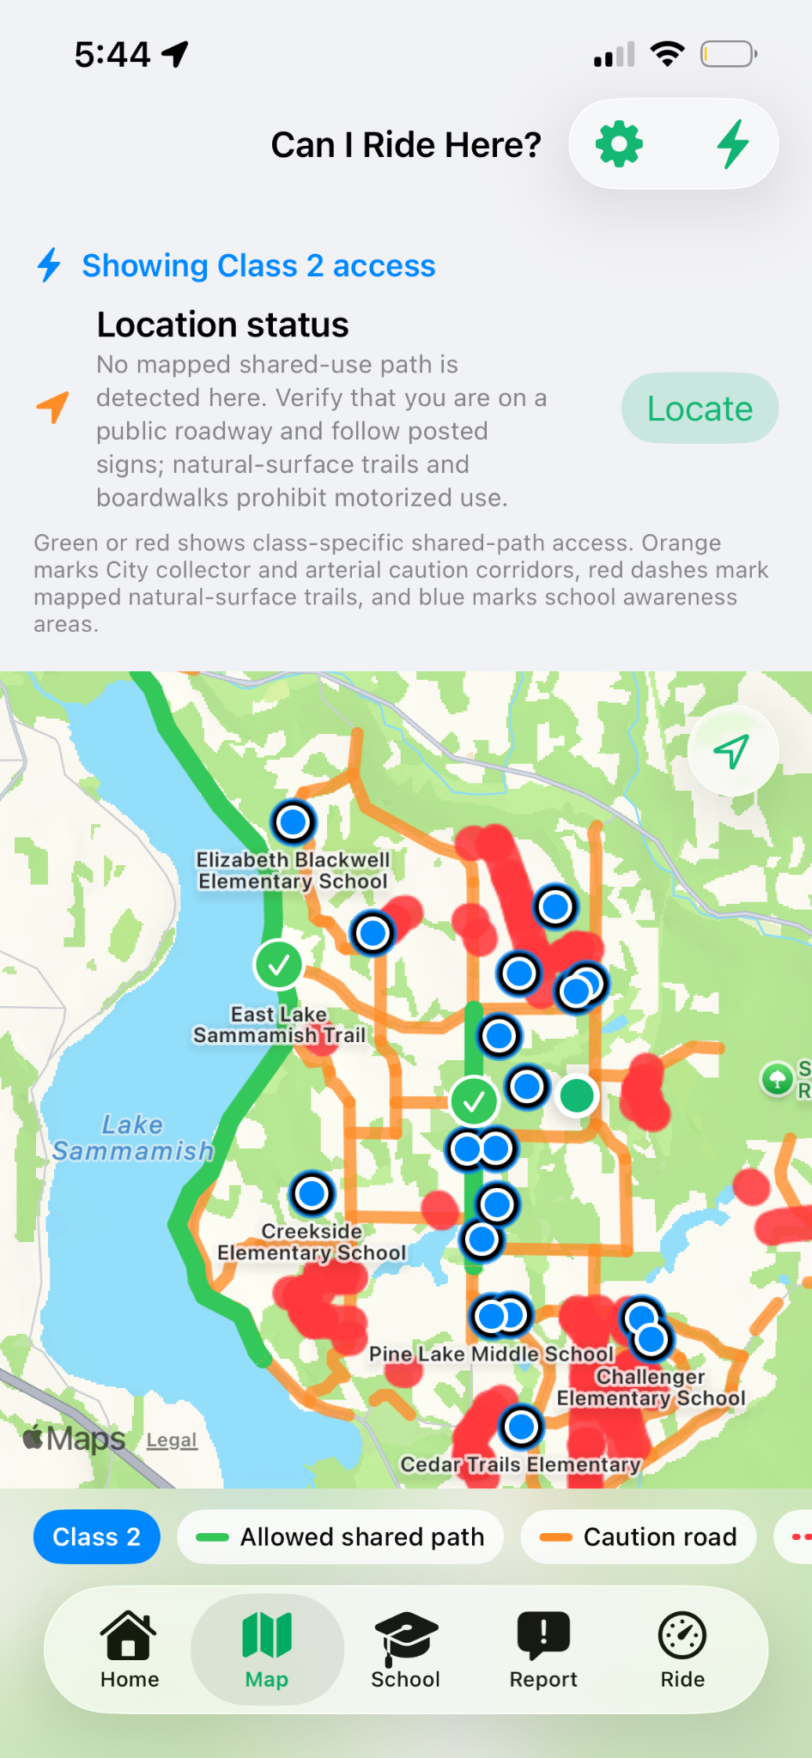
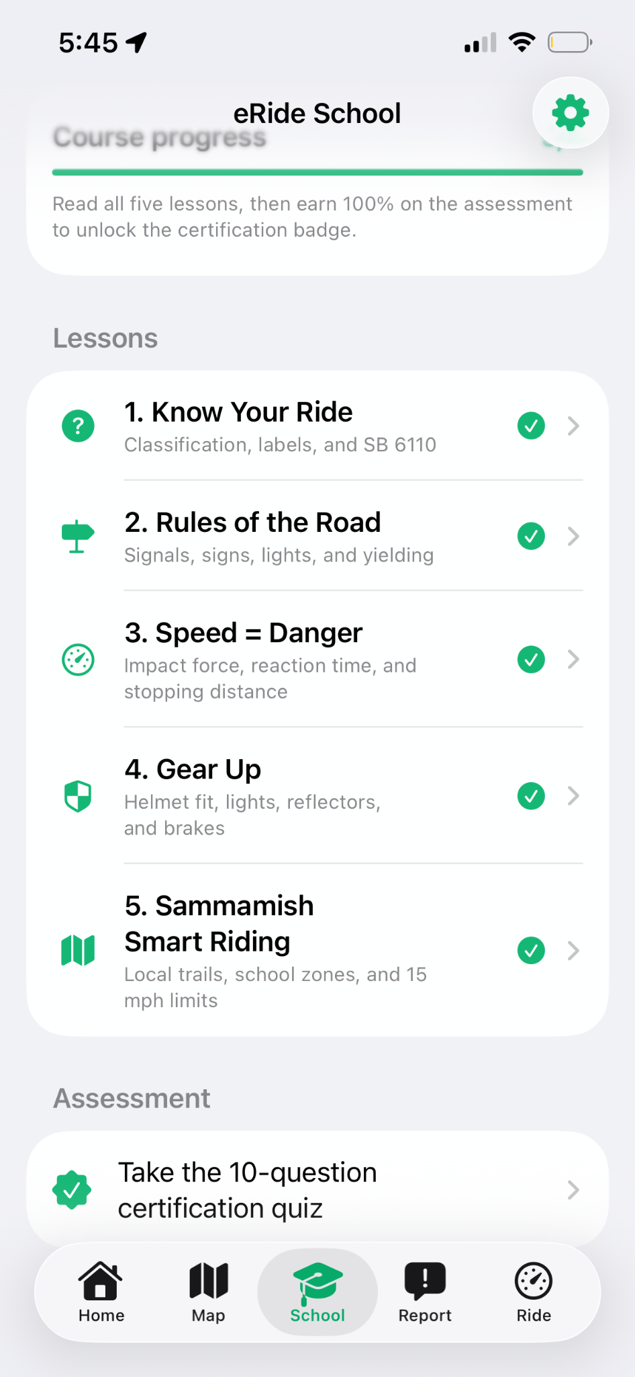
Safety Map
eRide School

Slide 12
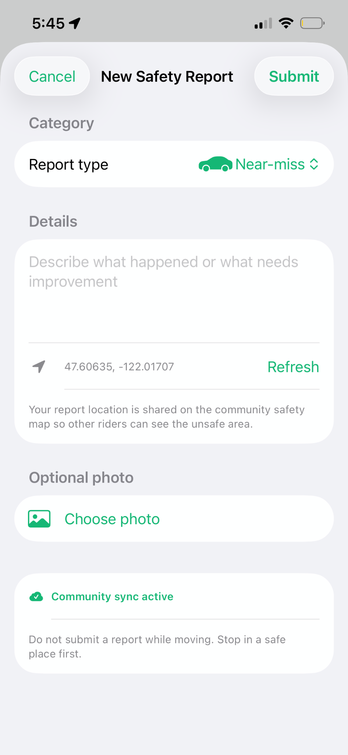
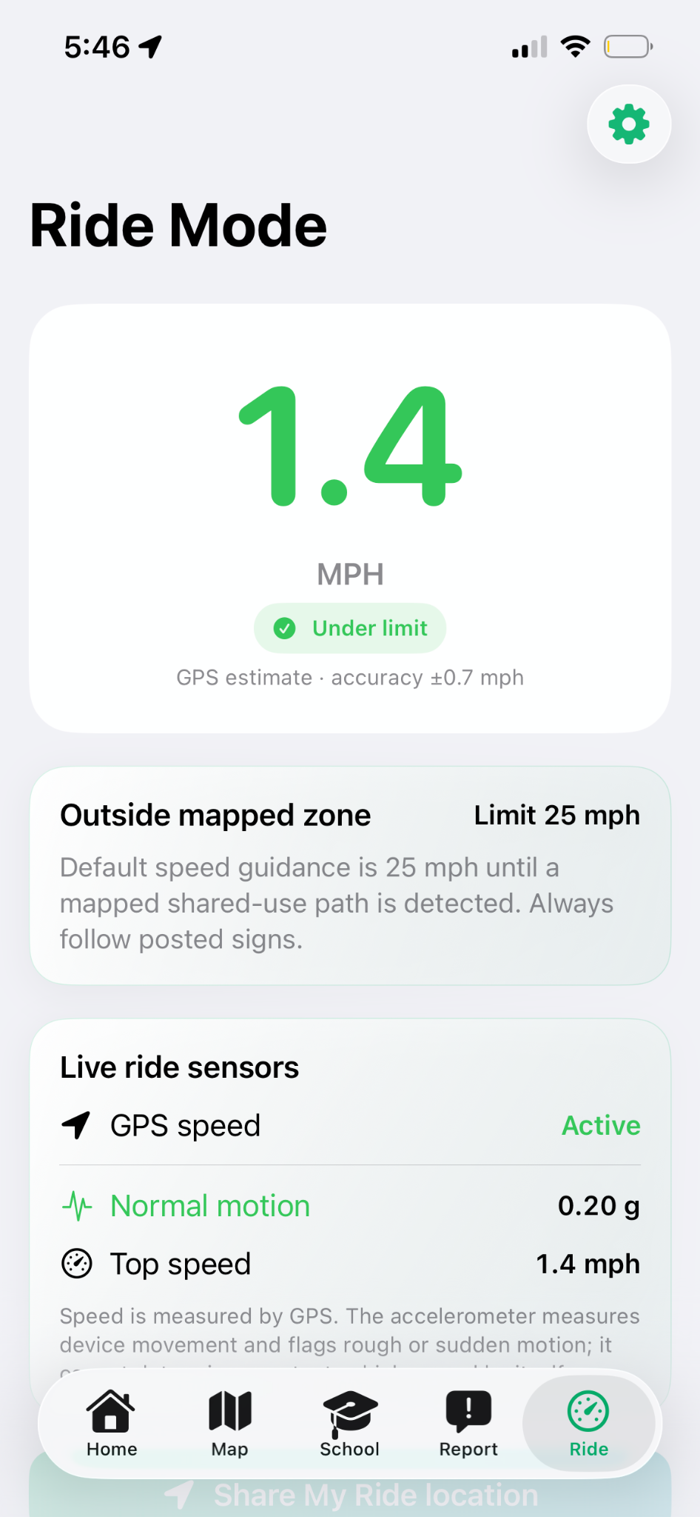
Safety Reports
Ride Mode

Slide 13
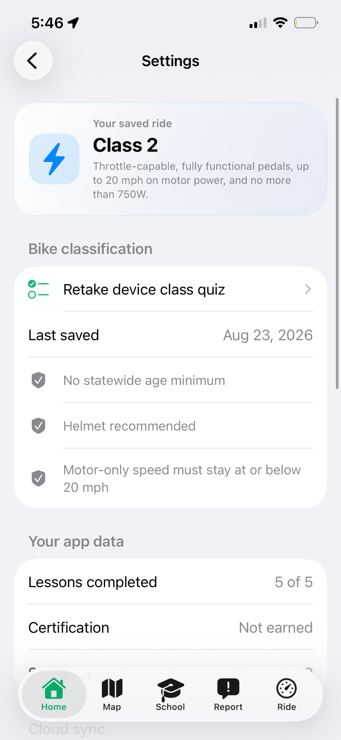
Settings

Slide 14

How Do I Plan to Improve the App in the future?
01
02
03
More local data
Feedback
Expansion
Add more routes and verified city guidance.
Receive feedback from law enforcement and implement accurate information.
Expand the app’s area of usage to not just Samammish, but other cities across Washington State.
Annirudh Raman
Eastlake High School • 9th Grade
annirudh.raman@gmail.com
Notes:
[Sources]
- https://www.congressionalappchallenge.us/wp-content/uploads/2026/05/2026-CAC-Rules.pdf
- /Users/annirudhraman/Desktop/Coding Projects/eRideSafe Project /eRideSafe/Views/Components/DesignSystem.swift

Slide 15
Your Thoughts?

Slide 16
My Questions for Law Enforcement
What has your experience been as law enforcement with e-bike safety?
What are the different reasons that accidents are happening?
How are parents involved in this?
What is working to solve the issue of e-bike safety and what isn’t?
What are some ways we could try to solve this issue?
Is the current focus of the app relevant to the issue?
How can the app be as beneficial as possible?
Does the app seem like a useful tool that can be used to ensure e-bike safety?

Slide 17
Thank You

